Slide 1
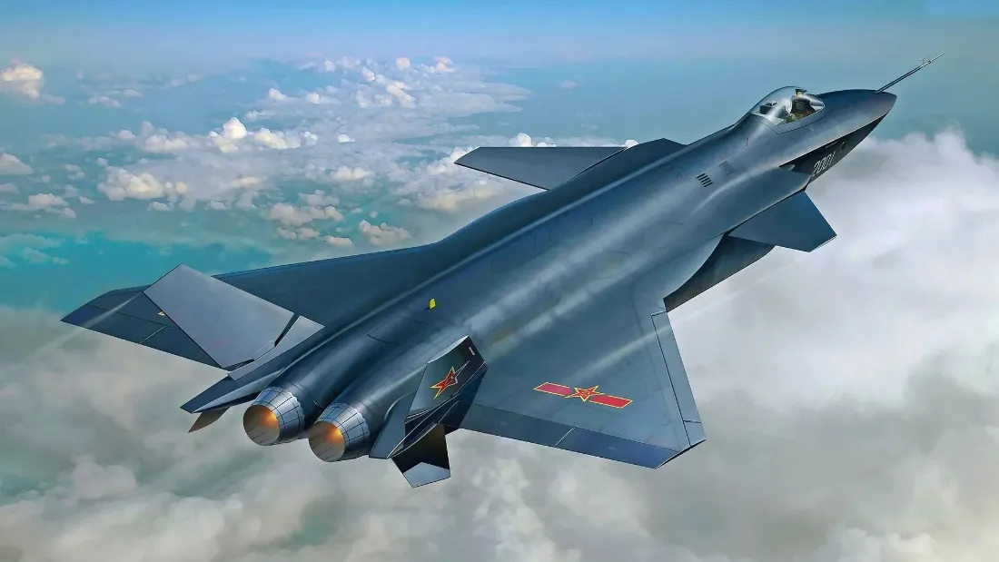
解放军东部战区位台岛周边组织“正义使命-2025”演习
The Eastern Theater Command of the PLA（解放军） organized the 'Justice Mission-2025' exercise around Taiwan Island

Slide 2
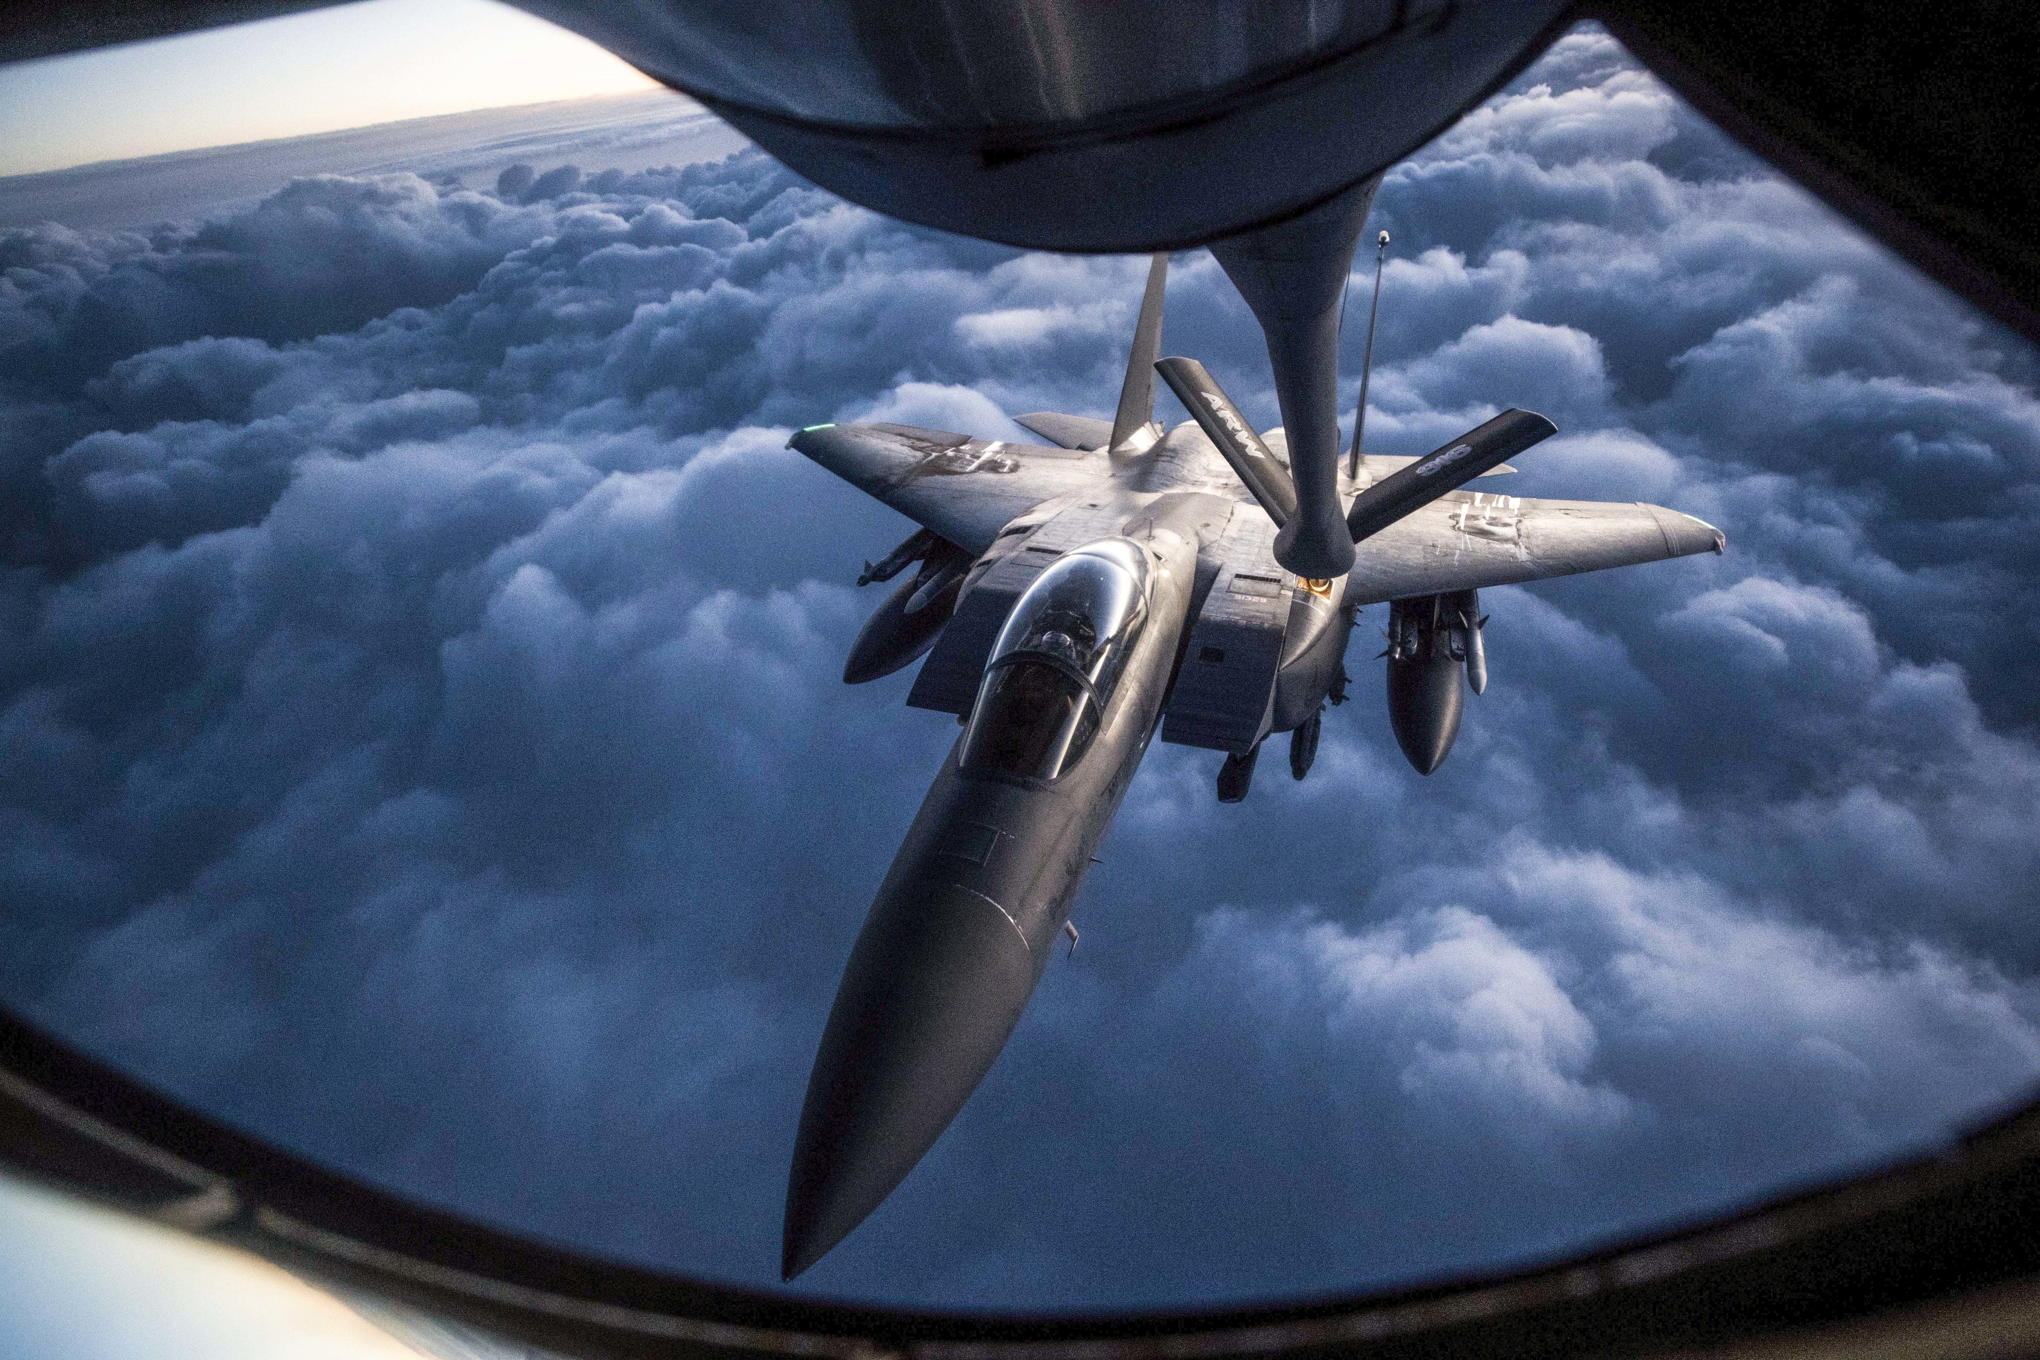
央视网消息（新闻联播）：12月29日开始，中国人民解放军东部战区组织陆军、海军、空军、火箭军等兵力，位台湾海峡、台岛北部、台岛西南、台岛东南、台岛以东等区域，开展代号为“正义使命-2025”的联合演习。
CCTV News (Xinwen Lianbo): Starting from December 29, the Eastern Theater Command of the Chinese People's Liberation Army organized forces from the army, navy, air force, and rocket force to conduct a joint exercise codenamed 'Operation Justice Mission-2025' in areas near the Taiwan Strait, the northern part of Taiwan Island, the southwest of Taiwan Island, the southeast of Taiwan Island, and east of Taiwan Island.
解放军东部战区位台岛周边组织“正义使命-2025”演习_新闻频道_央视网(cctv.com)

Slide 3
上午9时30分许，东部战区海军宝鸡舰编队、衢州舰编队、太原舰编队，分别位台岛西南、台岛北部、台岛东部海空域接续展开多型武器实弹射击演练。
Around 9:30 a.m., the Naval formations of the Baoji, Quzhou, and Taiyuan vessels from the Eastern Theater Command conducted live-fire exercises with multiple types of weapons in the air and sea areas southwest, north, and east of Taiwan Island, respectively.
我国最厉害吊的战舰之一 055护卫舰

Slide 4
抵达目标海域后，各编队迅速开展多轮主、副炮实弹射击。随后，各编队还连贯展开防空反导、对海实弹射击、联合反潜、联合海上突击等演练，成功检验“夺取海空制权、要港要域封控、联合精打击要”能力。
29日下午，两栖攻击舰海南舰编队在连续航行1万多海里后，准时抵达台岛东南海域，协同轰炸机编队、反舰常导作战力量开展舰机协同、对海打击、远程奔袭、综合保障等科目演练，检验了内线外线一体联动、兵力火力尽远制敌能力。
After reaching the target sea area, each formation quickly carried out multiple rounds of live-fire exercises with main and secondary guns. Subsequently, the formations also conducted coordinated drills in air defense and missile interception, live-fire exercises against sea targets, joint anti-submarine operations, and joint maritime assault, successfully testing their capabilities to 'seize sea and air control, enforce port and area blockades, and conduct precise joint strikes.'
On the afternoon of the 29th, after sailing more than 10,000 nautical miles continuously, the amphibious assault ship Hainan task force arrived on time in the southeastern waters of Taiwan. It conducted exercises in ship-air coordination, maritime strikes, long-range raids, and comprehensive support alongside a bomber formation and anti-ship conventional missile forces, testing the integrated inner- and outer-line operations and the capability of force and firepower to control the enemy from a distance.

Slide 5
凌晨时分，东部战区空军多型战机从多个机场起飞，歼击机、轰炸机、特种机、无人机等组成大规模空中编队，飞往台岛以东、台岛北部、台岛西南海空域，配合海上作战力量、协同远程火力，开展对海突击、区域制空、对陆打击、空中对抗、信息支援等科目演练，检验一体协同、夺取制权能力。
In the early hours of the morning, multiple types of aircraft from the Eastern Theater Command Air Force took off from various airports. Fighter jets, bombers, special aircraft, and drones formed a large-scale aerial formation and flew to the airspace east of Taiwan, north of Taiwan, and southwest of Taiwan. Coordinating with naval combat forces and collaborating with long-range firepower, they carried out exercises in sea strikes, regional air control, land attacks, aerial combat, and information support, testing integrated coordination and the ability to gain control of the air.

Slide 6
演习命令下达后，东部战区火箭军多支部队多型导弹发射车采取广域机动、多点多向等方式，装载实弹向预定阵地快速转进，准时在东南沿海某地域完成集结部署，即刻进入战斗状态。
这次行动，火箭军部队依托多平台、多渠道实时获取，有效整合目标数据，构建全维一体火力打击体系，对敌多艘舰船目标实施点名追瞄和模拟火力突击，对敌陆上固定重要军事目标进行多波次、大弹量模拟打击，有效检验常导力量打击能力。行动中，部队严密组织隐蔽伪装和电磁频谱管控，在不动声色中实现雷霆一击！
29日上午，东部战区陆军多个集团军的远箱火打击分队闻令而动，准时机动至任务地域，完成作战准备。
After the exercise orders were issued, multiple units of the Eastern Theater Command Rocket Force deployed various types of missile launch vehicles using wide-area mobility and multi-point, multi-directional movements. They loaded live ammunition and rapidly moved to designated positions, assembling and deploying on schedule in a certain area along the southeast coast, immediately entering combat readiness.
In this operation, the Rocket Force units relied on multiple platforms and channels to obtain real-time information, effectively integrating target data to build an all-dimensional integrated firepower strike system. They conducted pinpoint tracking and simulated fire assaults on multiple enemy ships, carried out multiple waves of large-scale simulated strikes on important fixed land military targets, and effectively tested the strike capabilities of conventional missile forces. During the action, the units meticulously organized concealment, camouflage, and electromagnetic spectrum control, achieving a thunderous strike without drawing attention!
On the morning of the 29th, the long-range fire strike detachments of several group armies of the Eastern Theater Command Army moved promptly upon receiving the orders, mobilizing to the mission area on time and completing their combat preparations.

Slide 7
周原为商朝地处西陲的一个小属国。周文王在位50年，实行许多正确的政策，国力逐渐强大，逝世时天下三分已得其二，为灭商奠定了基础。文王死后，武王即位，以太公望为师，周公旦为辅。召公、毕公都在王的左右。 当姬发积极筹划灭商的时候，当时的商政治上已十分腐败。武王决定乘机搞一次会师演习,以了解自己的号召力和军事状况。结果在出征时诸侯小国纷纷响应，率领人马前来孟津助战，使周武王增强了灭商的信心。但是，因时机还未完全成熟，还是班师回朝了。这次灭商预演，史称“孟津之会”或“孟津观兵”。
Zhou was a small vassal state located on the western frontier of the Shang Dynasty. King Wen of Zhou reigned for 50 years, implementing many wise policies, gradually strengthening the state’s power. By the time of his death, two-thirds of the world had already been won, laying the foundation for the eventual overthrow of the Shang. After King Wen's death, King Wu ascended the throne, with Jiang Taigong as his mentor and Duke of Zhou Dan as his assistant. Duke Zhao and Duke Bi were both by the king's side. When Ji Fa actively planned the destruction of the Shang, the Shang political system had already become extremely corrupt. King Wu decided to take advantage of the situation to conduct a joint military exercise to test his influence and the state of his military forces. As a result, when the campaign commenced, minor vassal states responded in large numbers, bringing troops to Mengjin to assist in the battle, which boosted King Wu of Zhou’s confidence in overcoming the Shang. However, since the timing was not yet fully ripe, the forces returned to the capital. This prelude to the conquest of Shang is historically known as the 'Assembly at Mengjin' or 'Inspection of Troops at Mengjin.'

Slide 8
你有什么启发？
What the hell the insights do you have?
啊？高超音速导弹价格，已经被中国民企打下来了？！_哔哩哔哩_bilibili https://www.bilibili.com/video/BV1evSkBAEAx/?spm_id_from=333.337.search-card.all.click

Slide 9

谢谢观赏

